Slide 1
Effects on Financial Status

Slide 2
Compare Income Estimates between US Census Income Data Sets
Income and earnings estimates in the 2009-2013 ACS 5-year data set are inflation-adjusted to 2013 dollars.
Income and earnings estimates in the 2014-2018 ACS 5-year data set are inflation-adjusted to 2018 dollars.

Slide 3
Inflation-Adjust the Income from 2009-2013 ACS5 to 2014-2018 ACS5 Data Sets
2018 CPI-US-RS = 369.8
2013 CPI-US-RS = 342.5
1.07970803
2013 Estimate Columns x 1.07970803
Inflation-Adjusted Estimate
Income Per Capita
Median Household Income
Inflation-Adjusted Estimate = 2013 Estimate x (2018 CPI-U-RS / 2013 CPI-U-RS)

Slide 4
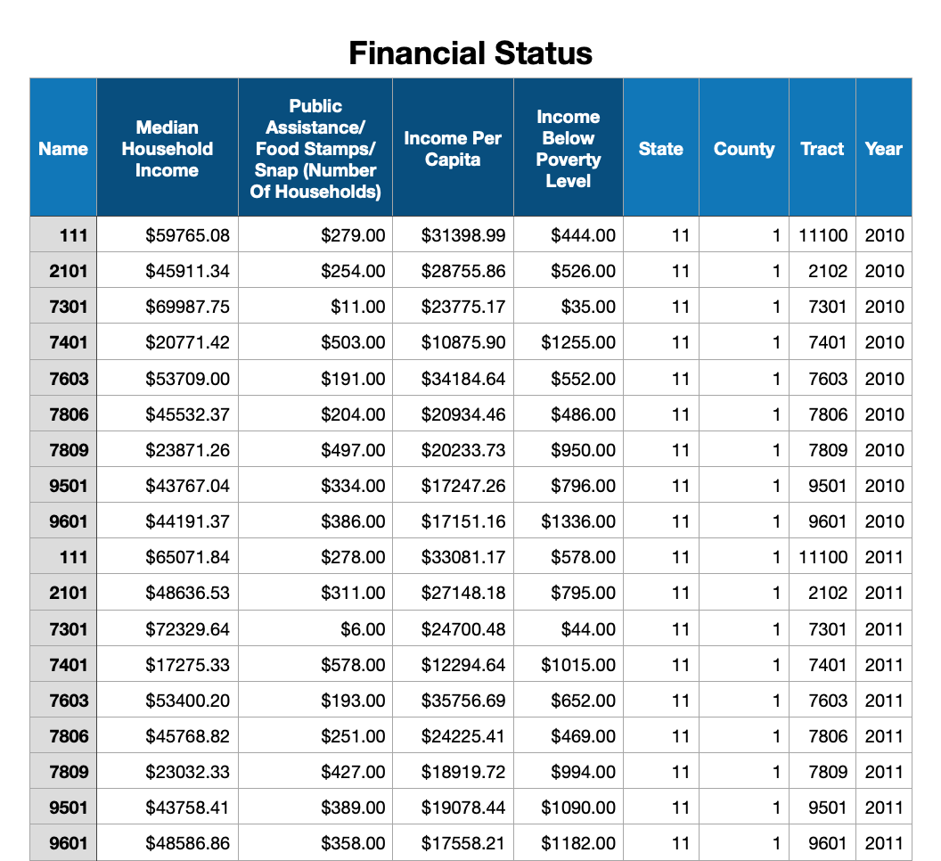
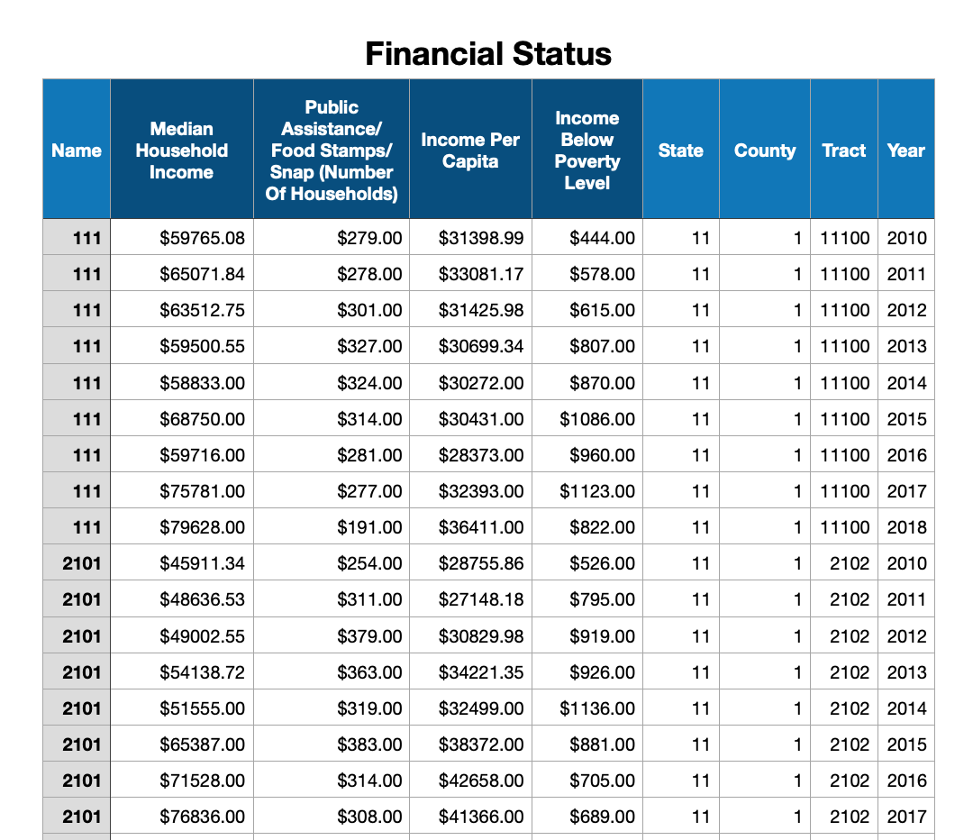
Financial Data Sets
Sorted by Tracts/Areas
Sorted by Year

Slide 5
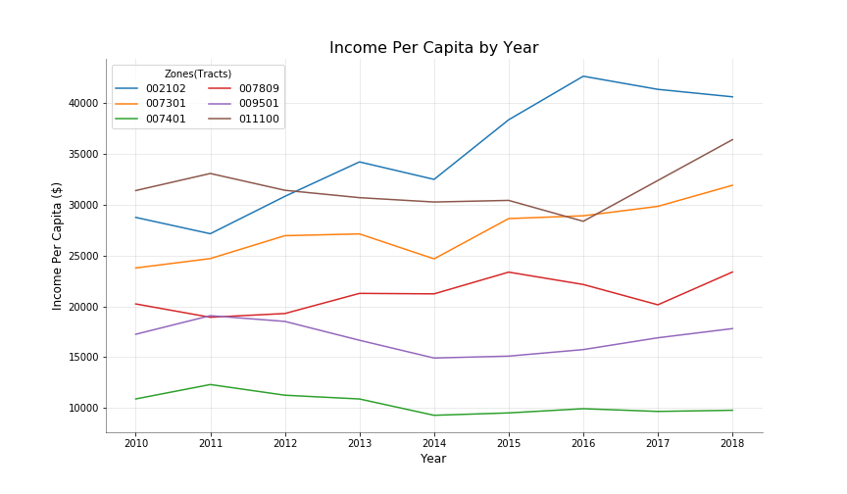
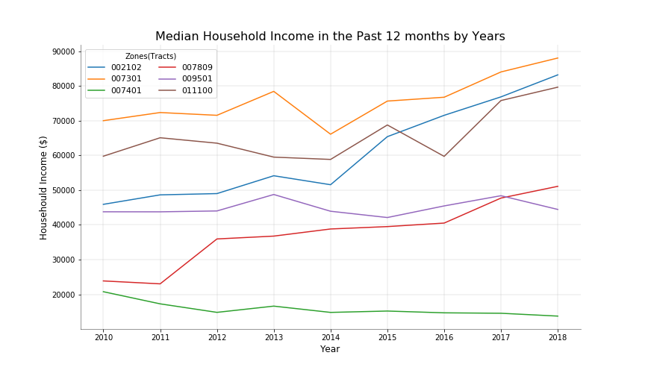
Earning Changes
Income Per Capita
Median Household Income

Slide 6
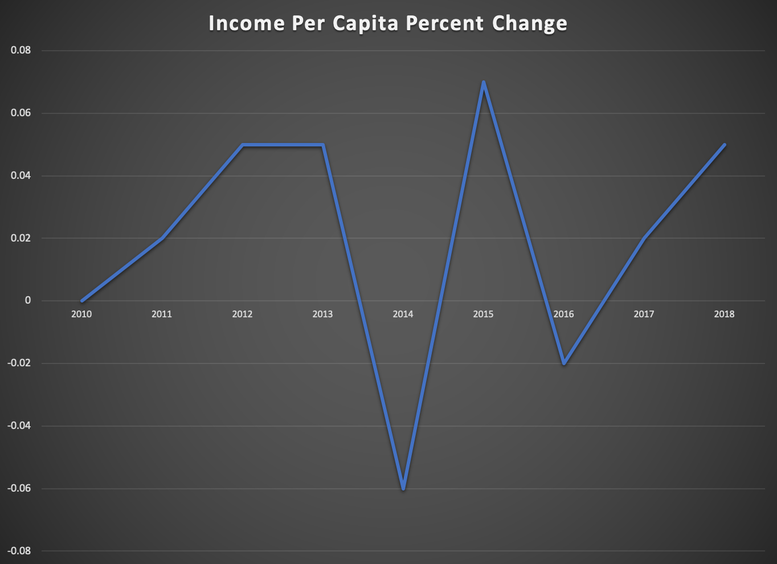
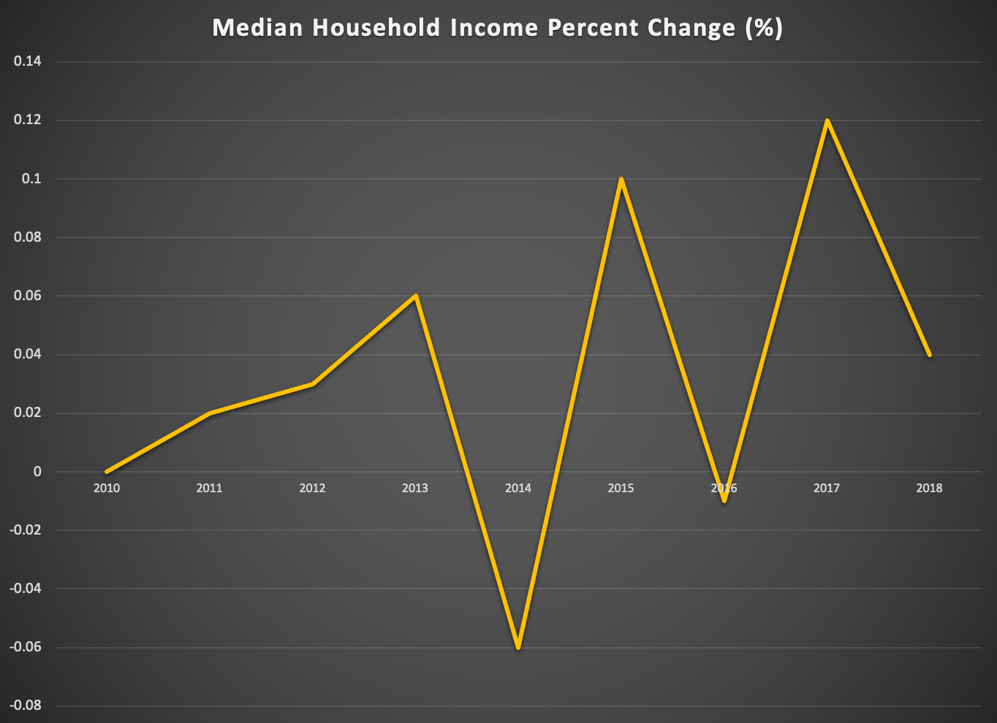
Earning Percent Changes (%)
Median Household Income
Income Per Capita

Slide 7
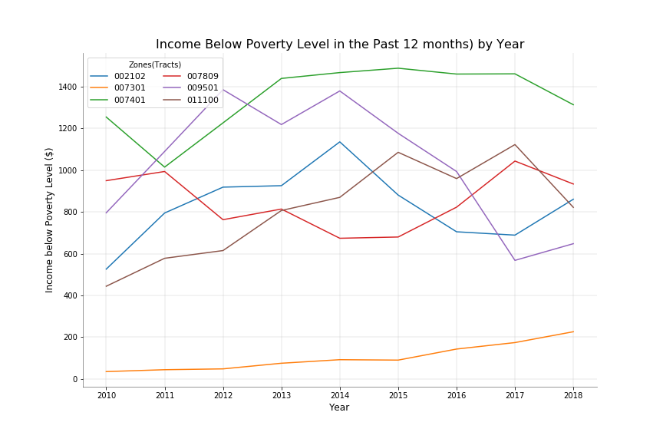
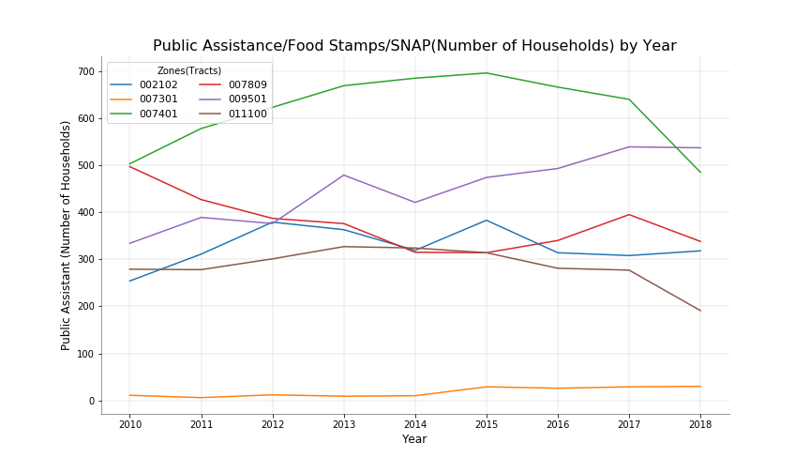
Poverty Stage Changes
Income Below Poverty Level
Public Assistances Needed

Slide 8
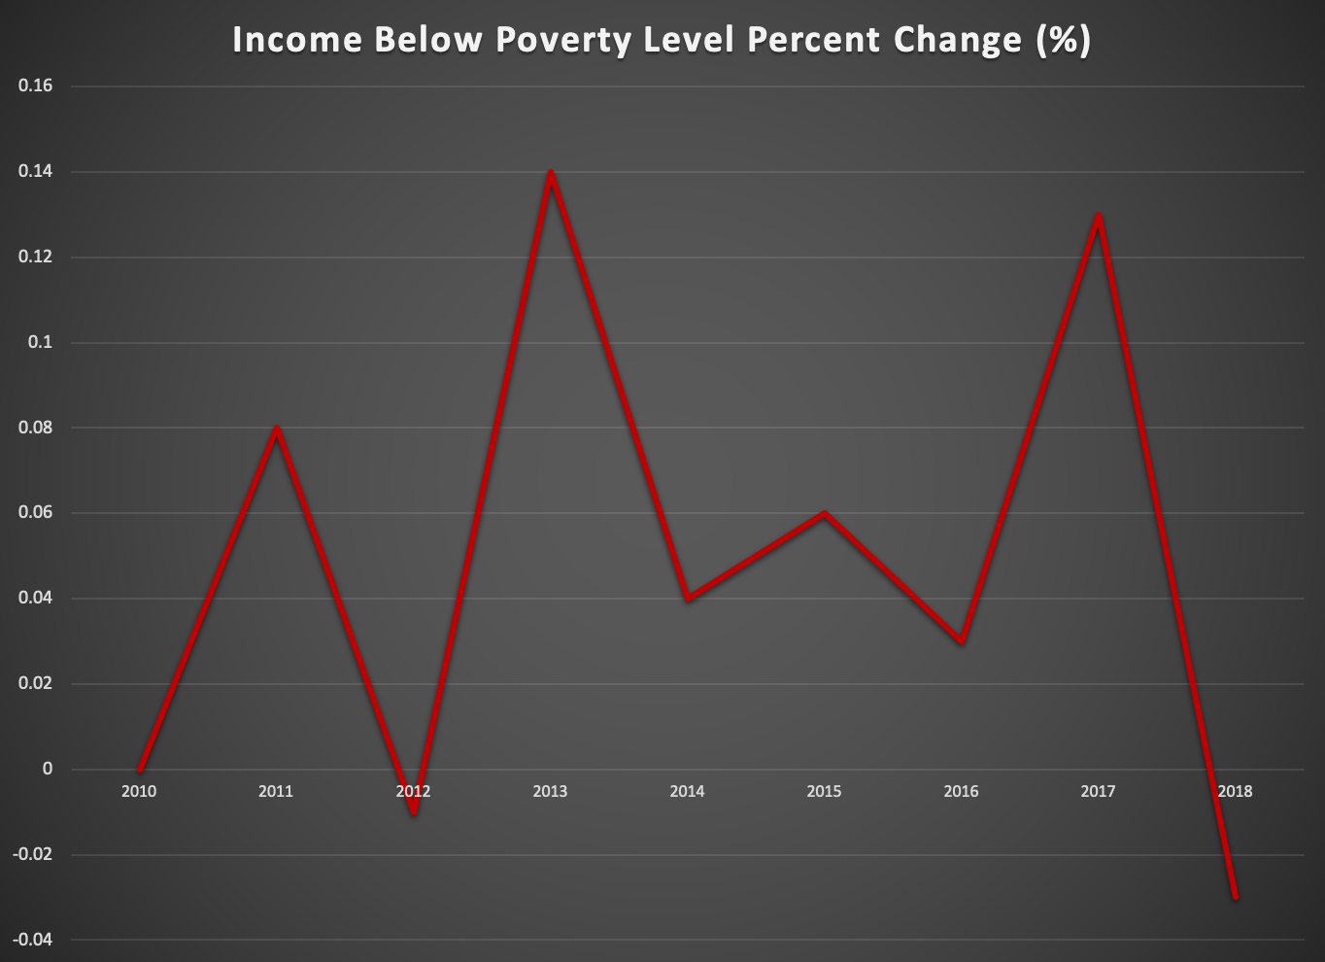
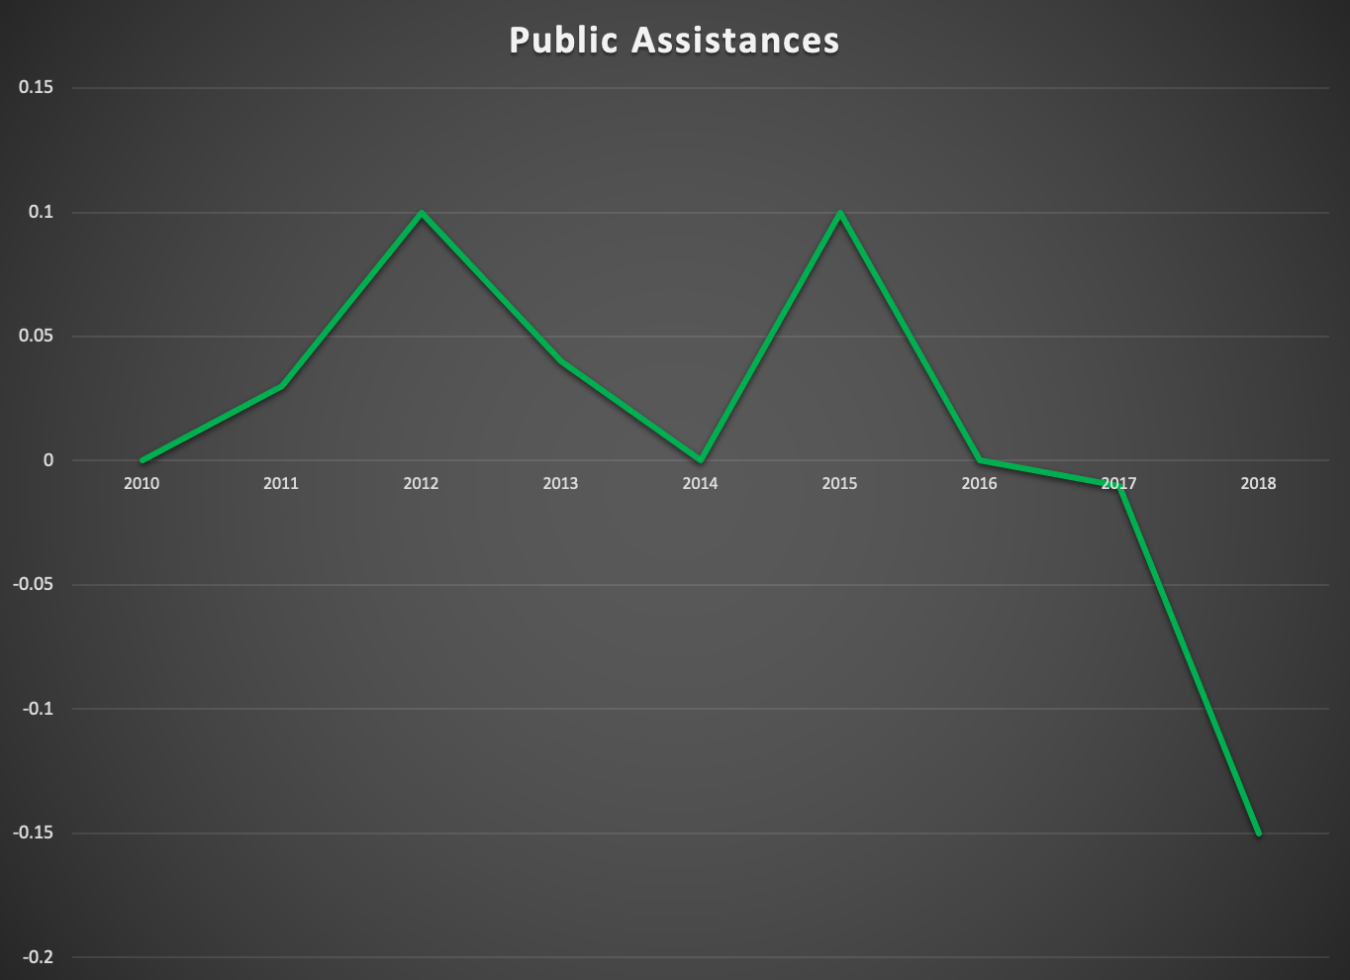
Poverty Stage Percent Changes (%)
Public Assistance Needed
Income Below Poverty Level

Slide 9
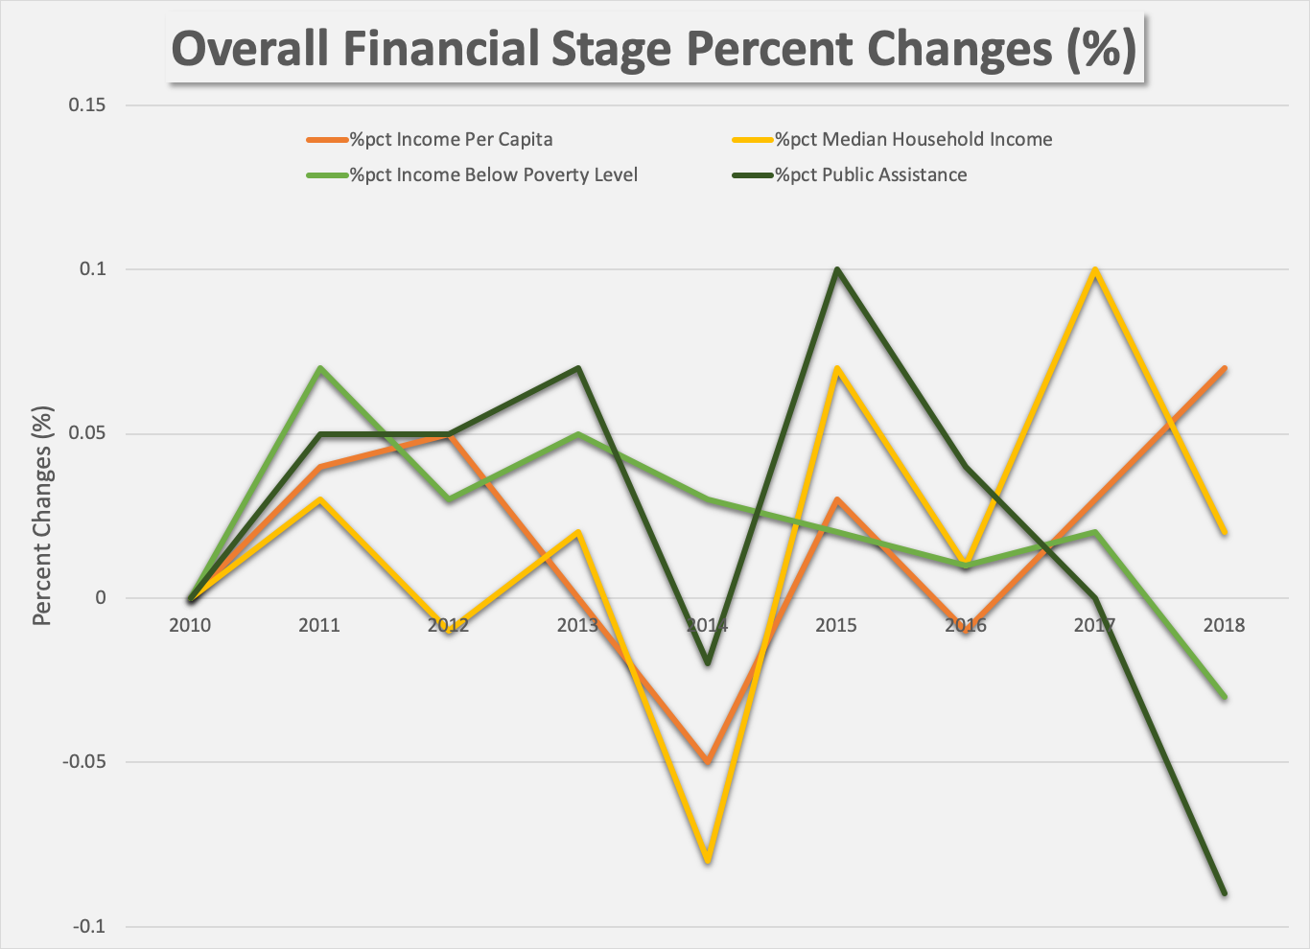
Overall Financial Status Percent Changes (%)

